Slide 1
Introduction to Sensory Circuits
This presentation will help:
Introduce staff to sensory circuits
Explain the benefits of sensory circuits
Direct staff to further information about sensory circuits

Slide 2
About Sensory Circuits
Sensory circuits are great to set up at the beginning of the school day, particularly for pupils with physical and sensory issues.
These pupils might be experiencing issues with attention, physical abilities in PE, and they may have difficulty with handwriting.

Slide 3
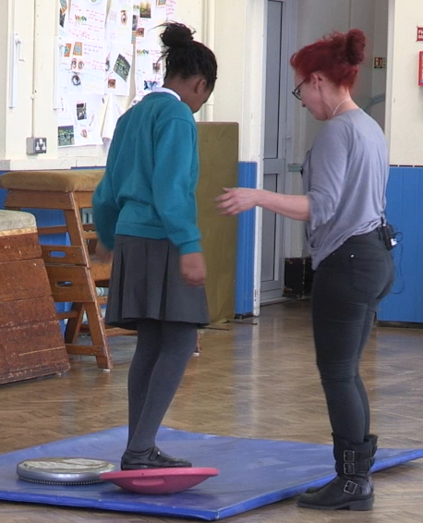
Benefits of Sensory Circuits
Sensory circuits have many benefits.
They help:
calm sensory systems
support body awareness
help physical and motor skills
prepare pupils for learning.

Slide 4
Equipment for Sensory Circuits
Sensory circuits can be set up with cheap equipment, much of which you may already have, and they can be completed in a larger space, such as the school hall.
You need equipment like balance boards, exercise balls, and skipping ropes.
This equipment can be used in multiple ways, it doesn’t need to be expensive and you don’t need a lot of it.

Slide 5
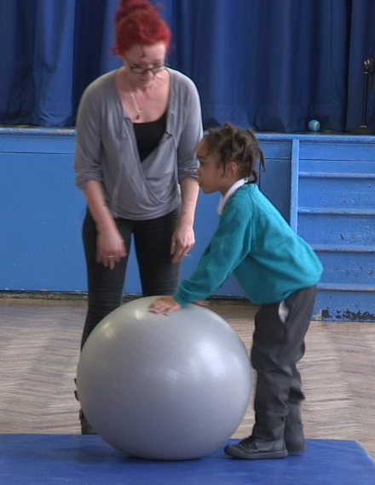
Safety and Sensory Circuits
Please consider safety during exercises if using equipment like gym balls and scooter boards as some might not use equipment in the ways that have been suggested.
Also look out for over stimulation such as squealing, spinning, or running.
Do some calming activities that include stretching, weight bearing and resistance with these pupils.

Slide 6
Example Sensory Circuits
An example sensory circuit might have 5 stations, each with a piece of equipment.
Children can do an exercise using a piece of equipment on every station for a short length of time until they move onto the next station.
Each piece of equipment can be used in many ways in different circuits to support different movements.

Slide 7
Example Sensory Circuits
The equipment we might use in an example circuit includes the below, but you can use many other items:
Scooter board – a child could be on their front pulling with hands to support
Gym ball – a child could sit on a gym ball and bounce
Skipping rope – a child could lay it down and jump side to side
Balance board – a child could balance on two feet and stand
Bean bags or balls – a child could lift 2 balls or beanbags above their head 10 times

Slide 8
More on Sensory Circuits
We have created a resource sheet which lists equipment that can be used in sensory circuits and the many different ways each piece can be used to support a range of skills.
Sensory circuits can make such a difference to students with physical and sensory needs that we urge you to use these, alongside other quality resources, to support pupils in your school develop and learn
Sensory Circuits: A Sensory Motor Skills Programme for Children by Jane Horwood is a good investment for getting started

